Slide 1
The Roman Period and the Middle Ages

Slide 2
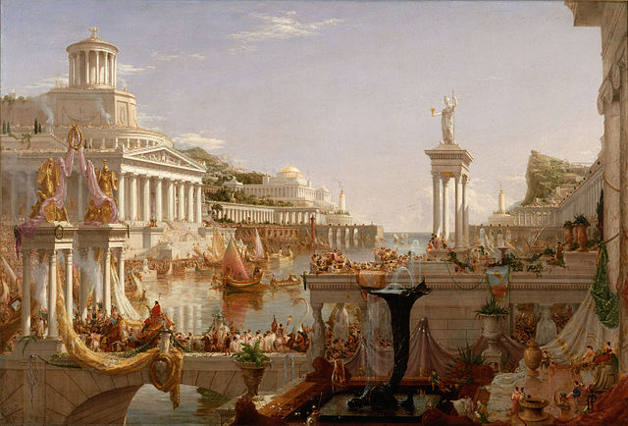
Context
As early as the 2nd century BCE, one million people lived in Rome, the population of the greater empire was fifty to one hundred million people
The Romans indulged in baths and swimming and exercise facilities as well as soaps, cosmetics, exotic clothing, jewelry, and music imported from Greece
Most, however, were not interested in science
Apart from their pioneering achievements in technology, geometry (Euclid and Pythagoras) , they held little interest for science
What flourished was therefore medicine

Slide 3
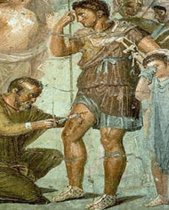
Roman medicine
Medicine flourished during to the need to sustain armies though it was primitive and full of miracle cures and superstition
Asclepiades (c. 124 BCE) was an influential greek physician studying mental disorders, he used music, baths, massage etc to help relieve
Galenus (c. 129-c. 199 BCE) stands second in importance only to Hippocrates, he wrote nearly 400 treatises covering numerous conditions and medical issues
Galenus also proposed an early personality theory based on the four humor theory and proposed the universe was dynamic and alive ( using ideas of pneuma to describe the different types of spirits)
His theories ( regarding pneuma theory ) were unchallenged until the 17rh century psychologists

Slide 4
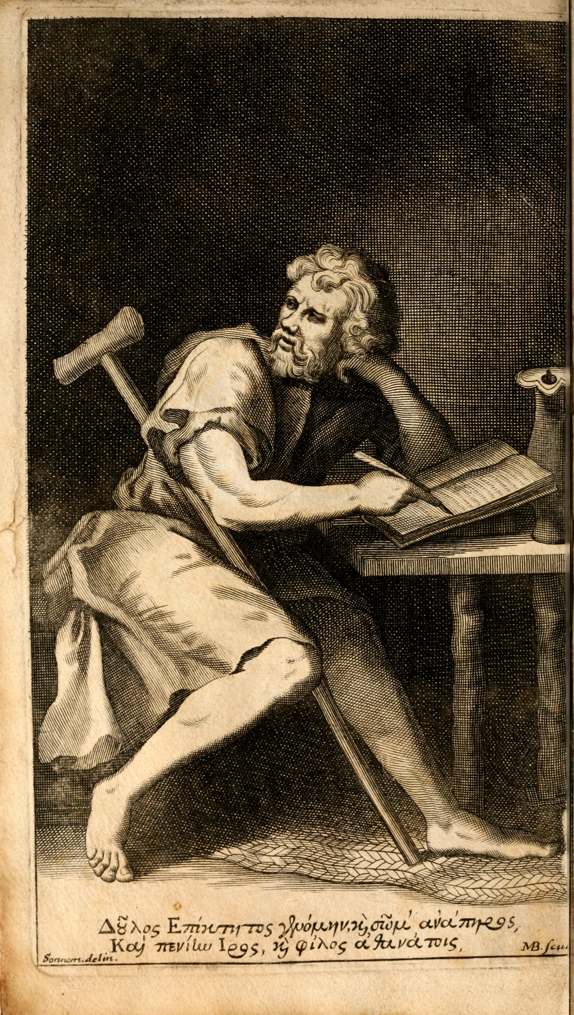
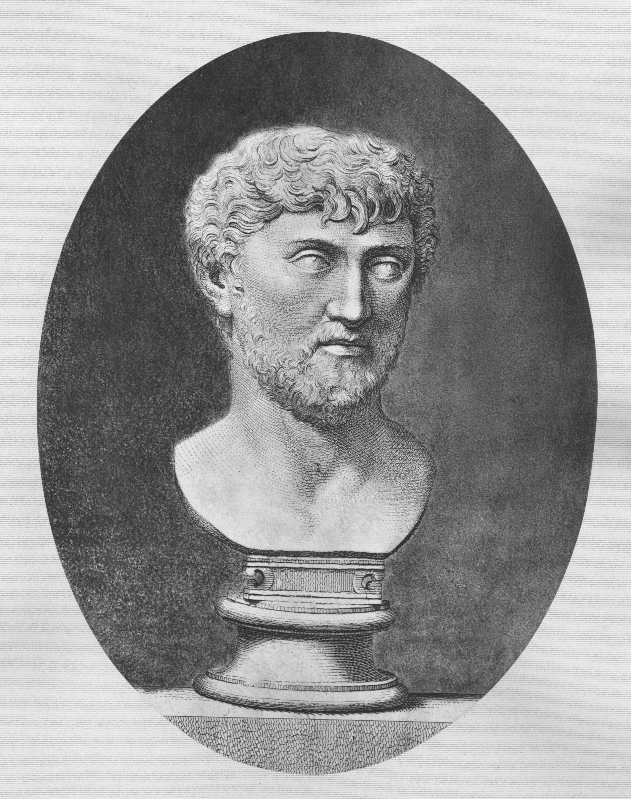
Roman philosophy
Stoicism - founded by Zeno of Cyprus thrived for over 500 years, focusing on discipline, self control and self will
Epictetus – taught stoic principles which he developed in his time as a slave, taught putting our faith in a higher force even if we do not know the purpose
Epicureanism – named after Epicurus of Samos, they believed pleasure is good and pain is evil to be avoided
Lucreatius argured that mind cannot exist separate from the body as well as believing things were composed of different shapes and sizes of atoms
Although an epicureanist, he valued piety and admired discipliine

Slide 5
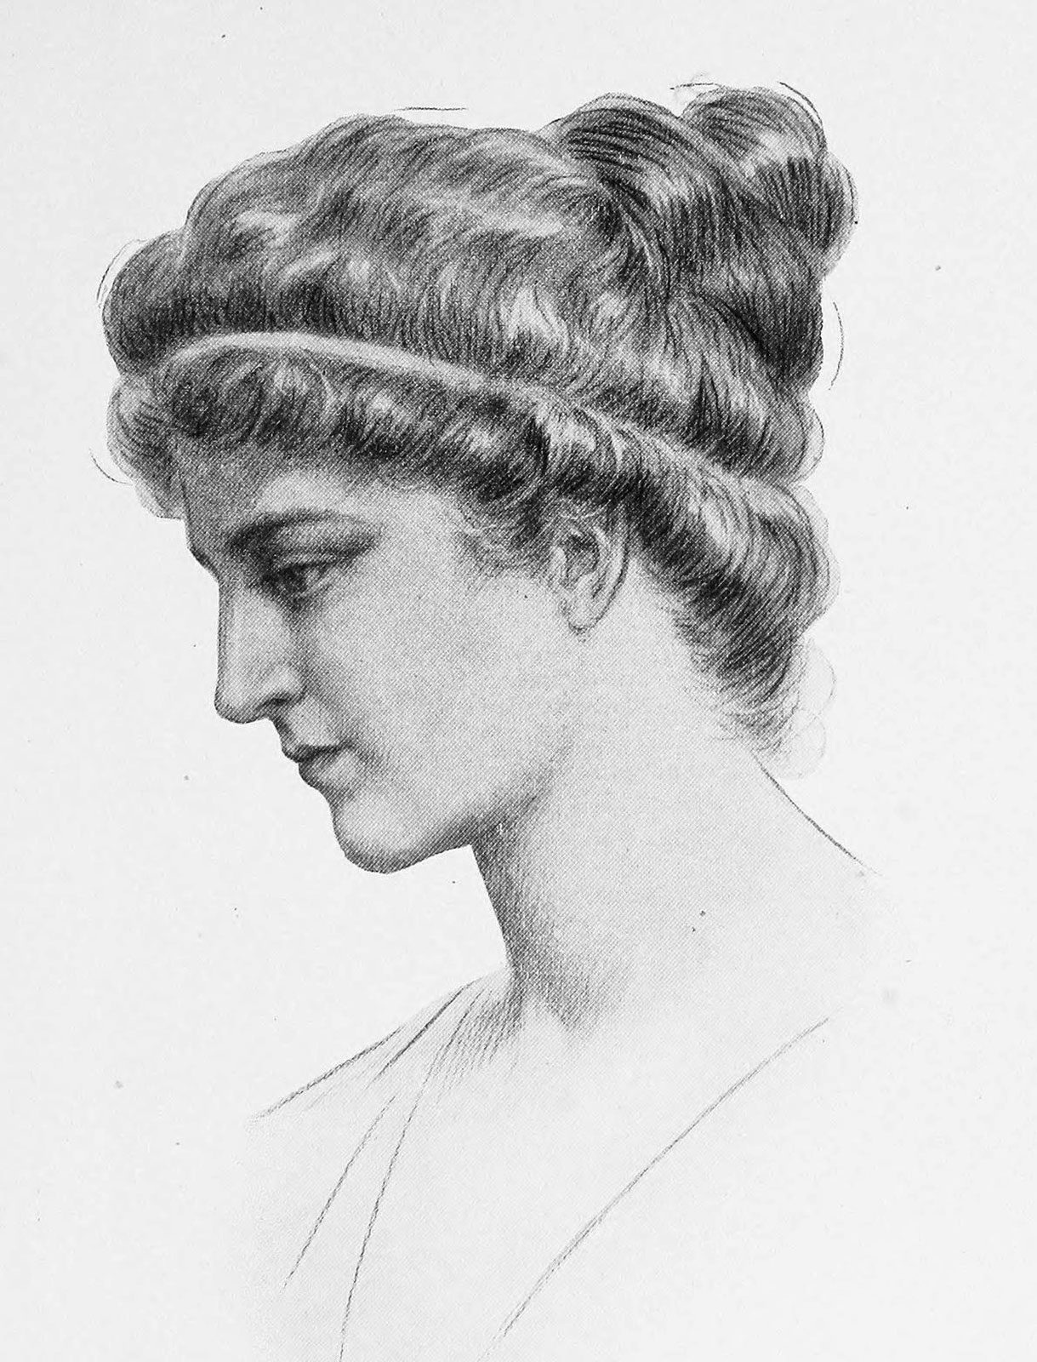
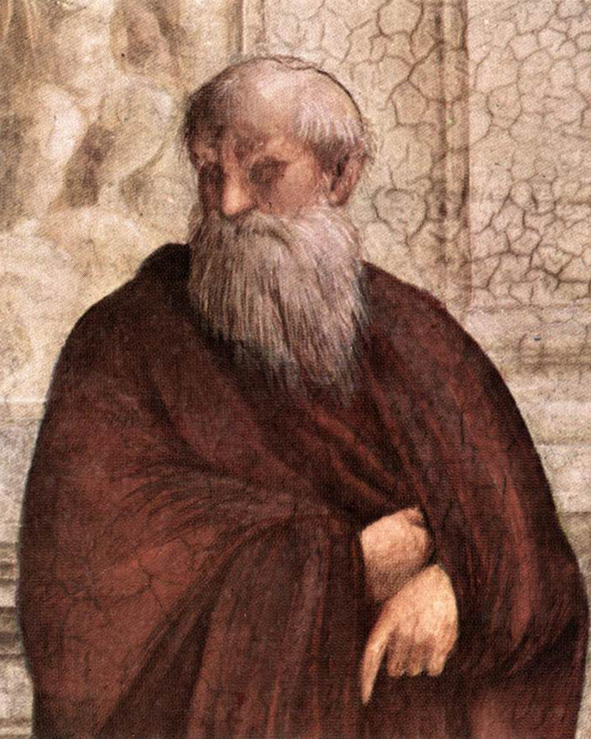
Roman philosophy
Neo-Platonism – most important school of philosopy following Aristotle, talking about topics such as activities of the soul, corruption and transience of the material world etc…
Plotinus is considered the father of neo platonism, inspired by Plato he merged platonic thought and religion
He stated that the percieving mind is not a subordinate of the external object, there could be no perception without an unitary percipient
Hypatia of Alexandria – most important leader of neo platonic thought in 4th century, she was expert in geometry and astronomy as well as using music for treatment of mental disorders

Slide 6
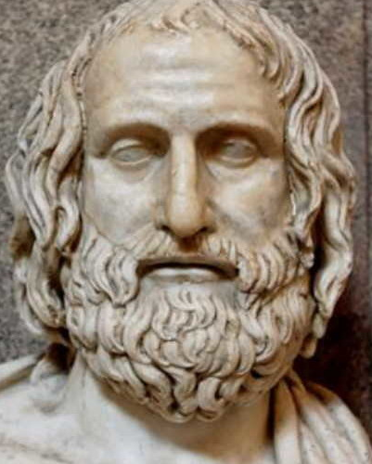
Roman philosophy
Skepticism – emphasized the changing nature of things, every argument has a counterargument
Sextus Empiricus – argued that human beings should suspend judgement on most things and live based on porbbable truths
Dogmatic certainty leads to frustration, unhappiness and delusionality while open mindedness leads to cotentment and helps cope with and accept uncertatny

Slide 7
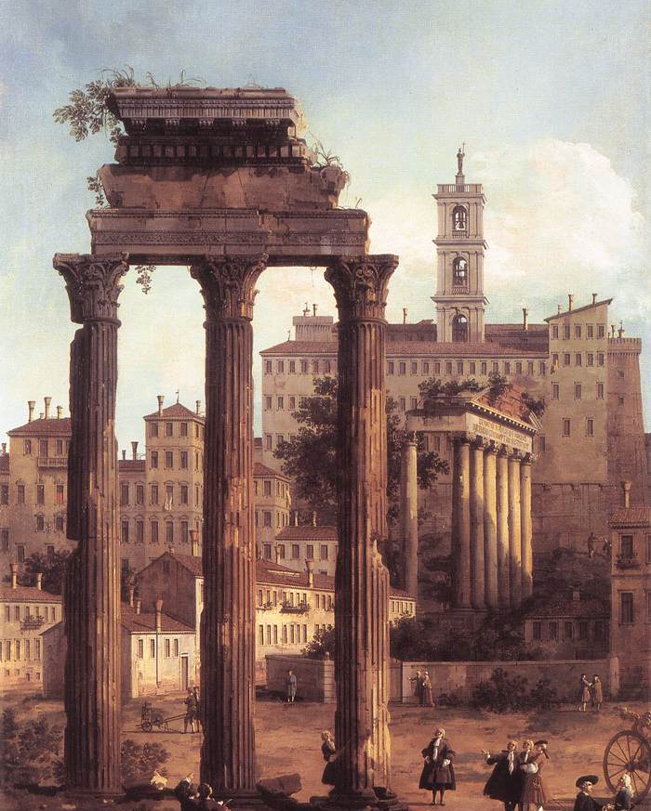
Important events
The fall of Rome – result of complex pattern of failing economy, morality, social and other institutions – resulted in tension with and ultimate taking over of Christianity
The early Christian faith – not a single school of thought but came to be after the 3d century
Roman emperor Constantine converted to chriistianity, issuing a declaration of religious freedom, intellectual authority was now placed on christian figures such as Augustine and Aquinas
The Medieval period – a thousand years of history covering an expanse from western shores of Spain to kingdoms in Northern and Baltic seas

Slide 8
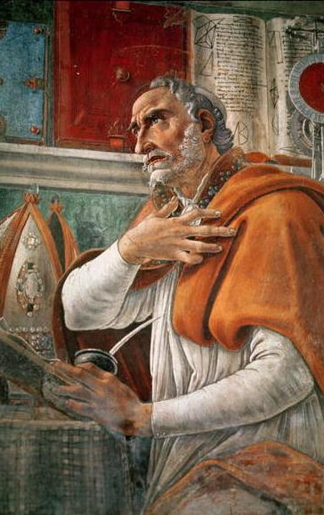
Aurelius Augustine
A pivotal figure from transition from Roman to Christian period, attended schools in Madura and Carthage to teach grammar and rhethoric
He lived a life of a rowdy nature but ultimately turned to God, leaving behind his previous vanitites
He recognized the patterns between Platonic and Christian thought
He spoke of many important topics such as; Infant motivation ( self seeking and asocial), grief ( with honesty and understanding ), habit breaking, memory ( tip of tongue phenomenna ), dreams ( forbidden pleasures )

Slide 9
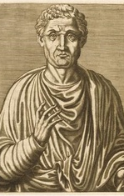
Boethius
A roman statesman and philosopher, used reason to support and defend Christian thought
In The Consolation, he tackles critical issues including the nature of evil, the attempted recon- ciliation of divine foreknowledge with human free will, and the nature of God
He influenced the sholastics of later Middle Ages who also used reason to defend the faith

Slide 10
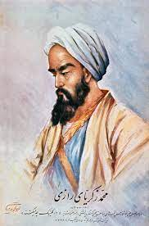
Islam
Rhazes – physician and author of medical textbooks that ranged from psychology to religion
He followed the tradition of Democritus, Empedocles and Hippocrates subscribing to the atomic theory and was also an empiricist
Avicenna – the most influential Arabian philosopher and physician
Despite his limited knowledge of anatomy, he speculated on the brain’s role in psychological disorders and observed a relationship between emotions and heart rate
He believed into a soul divided into three species nad integrated these ideas with Islamic thought

Slide 11
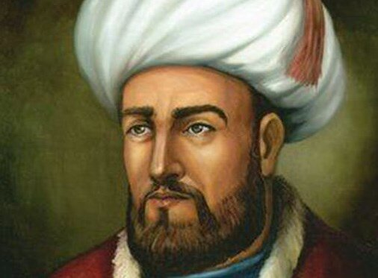
Islam
Al-Ghazali – a respected mystic and legal scholar lecturing to hundreds of students on legal philosophical and religious issues
He abandoned teachings to pursue meditation and solitude
Averroes – the last Arabian philosopher or the Middle Ages, wrote extensive commentaries on works of Aristotle and became a leading intellectual force
He observed that the retina is the sensitive part of the eye as well as patients immunity of smallpox

Slide 12
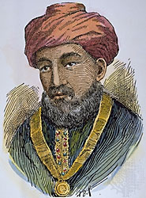
Judaism
Maimonides – greatest jewish philosopher of his time
Great truths were presented as symbolic or fictional stories and parables to ensure their meaning as spiritual message
He believed conflict between fate and reason ensues when people interpret scripture literally
Maimonides was an intellectual elitist who believed that many people had little need for his book and little need for reason

Slide 13
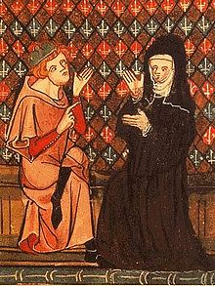
The rise of European universities
Peter Abelard – most renowned teacher and scholar of the early 12th century
He believed reason was gift of God as well as scripture and both thruths come from God, therefore can’t be contradicotory
He argued that all wise men were followers of God, and the Gods captured by scriptures were too conventional – first modern theologian
Heloise – the most renowned woman in the French kingdom in her wisdom
Like her spouse, Aberlard, she embraced a theological psychology where human actions were understood by intention

Slide 14
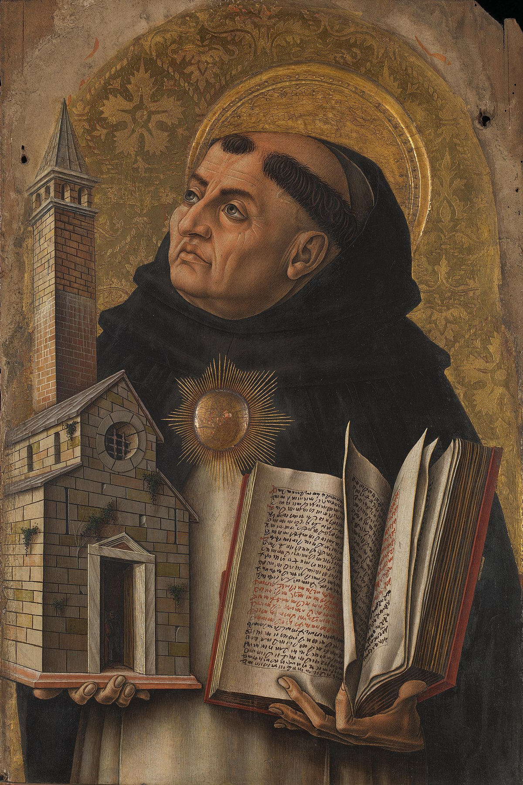
Roger Bacon – radical stand in understanding mathematics and science as keys to understanding God, hoping to reconcile faith and reason
His opus embraced optics, philology, mathematics, experimental science…
Thomas Aquinas – fascinated by psychology and leading Aristotelian of his time
Body and Soul – he argued for interdpendence of form and matter, rejecting the Platonic idea that soul was imprisionedi inside the body
Theory of Knowledge – psychology is based more on empiricism than authority, the sensory image is the key buliding block of knowledge
Willaim of Ockham – studied at Oxford university, argued that simplicty is superior to complexity

Slide 15
Thank you for your attention!
Bruno Gudić

