Slide 1
Origins of the science of mind
Ivana Periš
Faculty of Humanities and Social Sciences
University of Split

Slide 2
Introduction
Rene Descartes and John Locke – relation between mind or brain and behavior in the 19th century Physiology
Charles Darwin – work on evolution
17th century – England and Western Europe
social change - Industrial Revolution and protestant religious beliefs
upper classes and everyday people – development of a psychological sensibility

Slide 3
Decartes and Locke - philosophy
religion and conflict about correct beliefs provided background for thinking
Decartes and Locke – affected by context of religion and politics – emergence of Psychology
examplars of the new natural philosophy
quest to find certainty that could underpin civil life

Slide 4
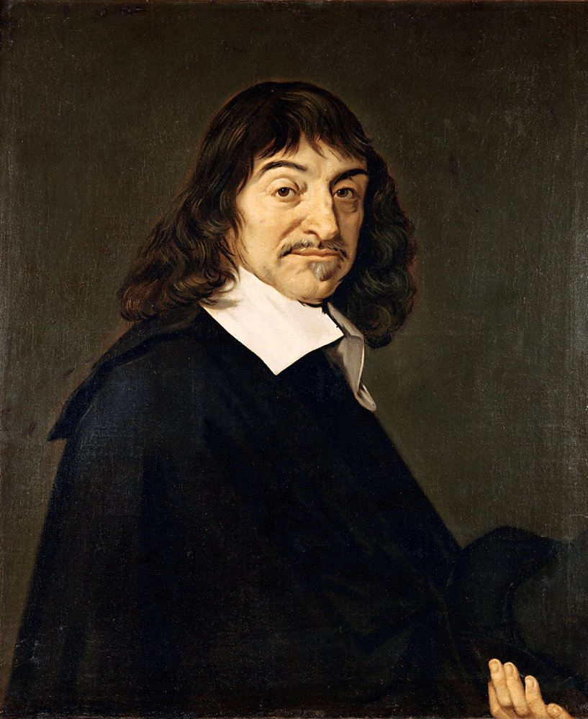
René Descartes (1596-1650)
philiosopher concerned with placing knowledge on a sure foundation
method of doubt
decided to accept things that were so clear and distinct that there could be no possibility of doubt
the soul (mind) is entirely distinct form the body
many functions should be considered properties of the body
mind-body dualism

Slide 5
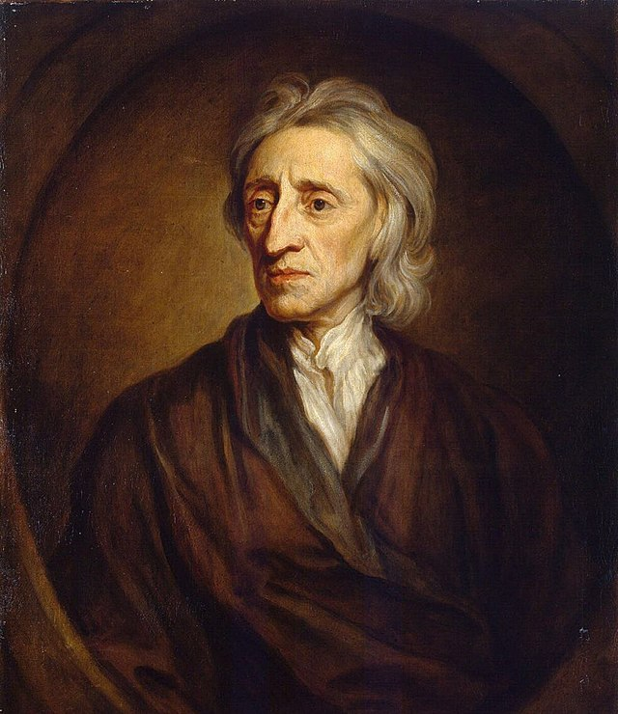
John Locke (1632-1704)
How do we gain knowledge?
concerned with finding a basis for civil society that would diminish the likelihood of incessant conflict and loss of human life
helping people form clear and distinct ideas, free of the excesses of political and religious enthusiasms
committed to finding basis for society
An Essay Concerning Human Understanding
rejected the notion of innate ideas
all ideas come through experience

Slide 6
Theories
associationism = Locke’s model which suggests that complex ideas form the combiantions of simple ideas
human experience central to knowledge
empiricism = knowledge gained through the senses

Slide 7
Physiology and medicine
efforts were made to systematically explore the functions of the human body
end of 19th century – the experiment became the method of discerning truth
laboratory = place where truth through experimentation was discovered
after Locke, in the 18th century, physicians began to describe the actions of the mind in physiological terms
David Hartley, Robert Whytt, William Cullen, Franz Joseph Gall, Jean- Pierre-Marie Flourens, Jean-Baptiste Bouillaud

Slide 8
Research in the Physiology of the Nervous System
the discovery of the distinction between sensory and motor nerves, made by Charles Bell in 1811 and Francois Magendie in 1822
created the conditions for the exploration of the psychological implications of nervous system functions
Bell and Magendie pointed out that each type of sensory nerve was specific to a sensory modality - vision, hearing, touch,…

Slide 9
Mechanization of the brain

Slide 10
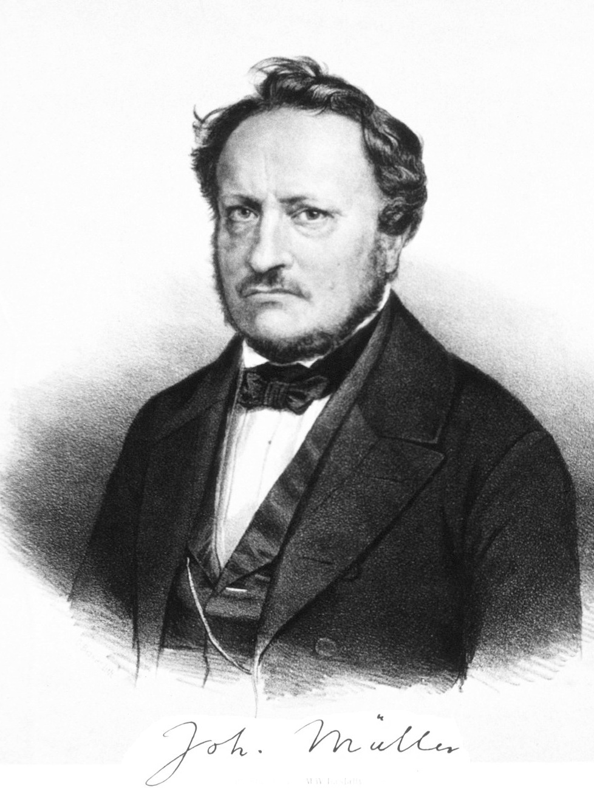
Johannes Müller (1801-1858)
German physiologist
Doctrine of specific nerve energies
extended the Bell-Magendie sensory-motor distinction
each sensory modality is specialized to respond in ways that are unique to it
it is the structure and function of our nervous system that determines what we sense
helped make a psychologically based Physiology possible

Slide 11
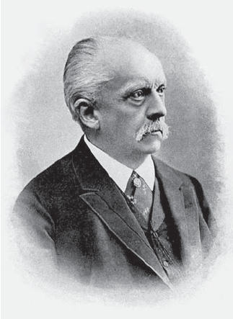
Hermann von Helmholtz (1821-1894)
German scientist and philosopher
the greatest scientist of 19th century
student with Müller
committed himself to scientific explanations that relied only on physical and chemical explanations for all phenomena
showed that the law of the conservation of energy applied to all living organisms – frogs as an experimental animal
formulated the law of the conservation of energy
His work on optics led to crucial distinction between sensation and perception

Slide 12
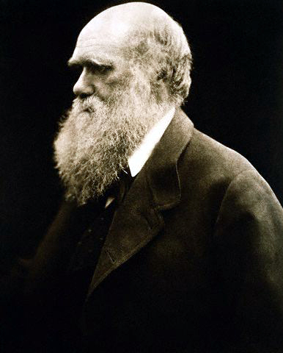
Charles Darwin (1809-1882)
Engish scientist, naturalist
provided convincing evidence that humans are part of the nature, subject to the same natural laws as all other creatures
Darwin’s approach called attention to the importance of considering the function of attributes and behaviors
created the space for the study of man in comparison with other animals

Slide 13
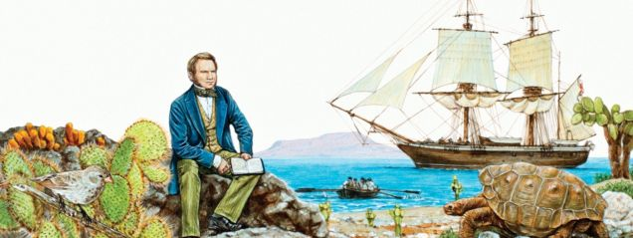
Journey to the Galapagos
in September 1831 Darwin decided to join ship Beagle on its trip to South america
a 2-year voyage was planned, instead it lasted for 5 years and became trip around the world
Darwin collected specimen and made geological observations
Darwin was a believer of the argument from design – all species are designed by Divine Creator for their specific place in nature
he came back to Britain with more than 2000 new specimen
after the trip, he became a world known scientist

Slide 14
THANK YOU FOR ATTENTION!

