Slide 1

EVERYDAY LIFE AND PSYCHOLOGICAL PRACTICES
History of Psychology
Lucija Šimunović

Slide 2
Introduction
soon after Psychology became established as a scientific field, the new psychologists began to envision how to make practical use of their new science

Slide 3
before formal practices there was a range of everyday practices
psychological practices→the use of psychological knowledge in making sense of oneself and the world, as well as the practical strategies of self- and social management that arise out of this knowledge
they were created thanks to the change in philosophical and medical discourses of the 18th and 19th centuries and because the emergence of a sense of self, comprising a sense of individuality and interiority

Slide 4

Whoa
This can be the part of the presentation where you can introduce yourself, write your email…

Slide 5
Table of contents
Subjectivity
Industrial revolution
01
02
Physiognomy&Phrenology
Adam Smith
03
04
the transformation from an agricultural to an industrial nation
judgment based on individual personal impressions and feelings and opinions rather than external facts
Scottish economist and philosopher
the appearance of someone's face
now abandoned study of the shape of the skull as indicative of the strengths of different faculties

Slide 6
01
Subjectivity
the emergence of scientific psychology depended on the existence of a certain kind of subjectivity that was itself forged from both elite and everyday practices

Slide 7
changes in people's sense of themselves
new technologies
Protestant religion
conduct books and diaries
commercial society
the movable-type printing press, invented by Johann Gutenberg
inner life & spiritual practices
increased literacy & emphasis on self-control
Perfected mirror, novel distribution

Slide 8
tools of self-epiphany

Slide 9

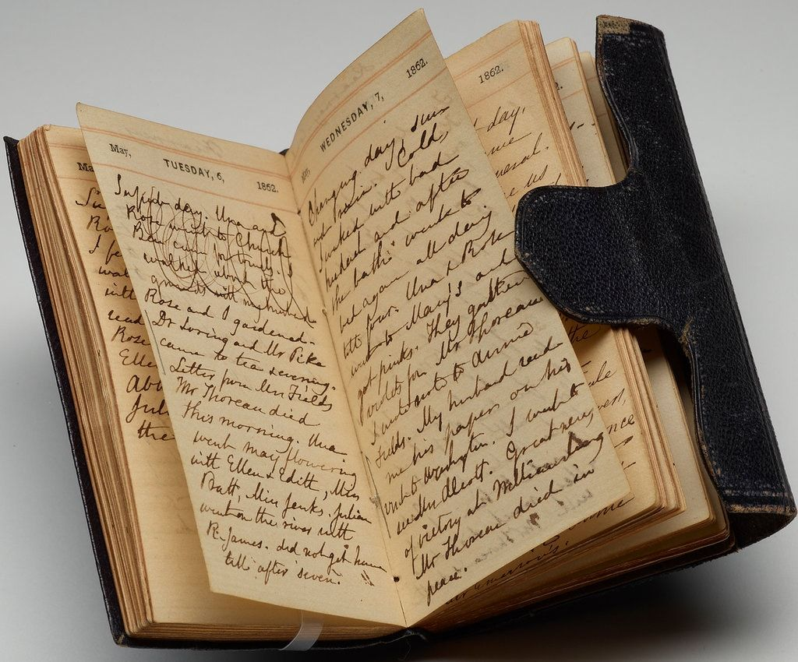
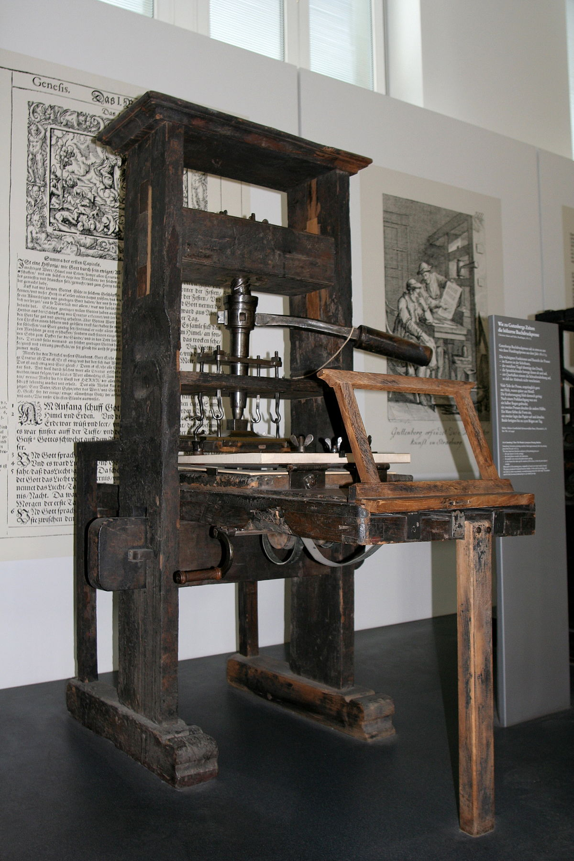

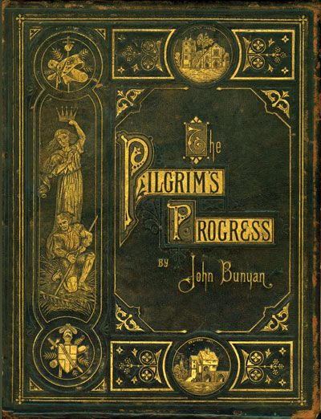


Slide 10
Prostestant Reformation outcomes
1
2
3
emphasis on a personal, private relationship with God and its maintenance, helped facilitate a sense of inwardness, of the need to pay attention to one's interior life, and thus increased a sense of subjectivity
technologies were developed to help Christians maintain their personal relation- ship with the divine
practices of everyday life attained a new importance, as one's faith was seen as much in conduct of business and management of the tasks of daily living as in church atten- dance

Slide 11
Changes in family life
marriage should be based on affection
Greater intimacy, affection and child orientation
-a change toward marriage being a choice, something one entered into voluntarily
-affection and love became more important as the basis for the marriage
-privacy became the norm
-the opinions of those outside the family came to have less influence on what happened within the family

Slide 12


Home
Household

Slide 13
02
Industrial revolution
Over the course of approximately a century and a half, from 1700 to 1860, England changed from being primarily an agricultural and cottage- industry state to the world's first industrialized country

Slide 14
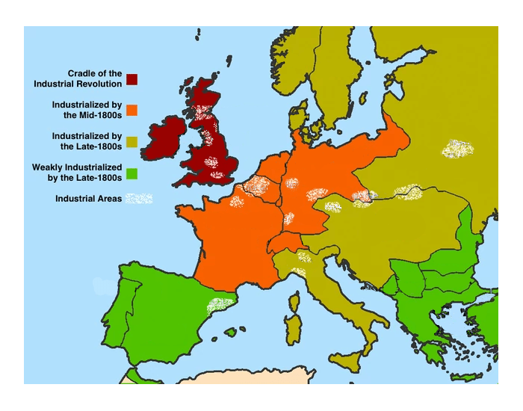
Expansion
+70%
From England unevenly across Europe

Slide 15
changes appeared in nearly every facet of life, from home to the market, in social relations among and within classes, and in how people understood themselves
people began to see themselves as living in an increasingly competitive world
world was progressively an urban one, as people moved from villages and towns to cities to take advantage of the new factory jobs becoming available

Slide 16

competiton because of meritocracy

Slide 17
03
Physiognomy and phrenology
based on the assumption of a link between the physical body, or some part of it, and internal qualities or abilities

Slide 18
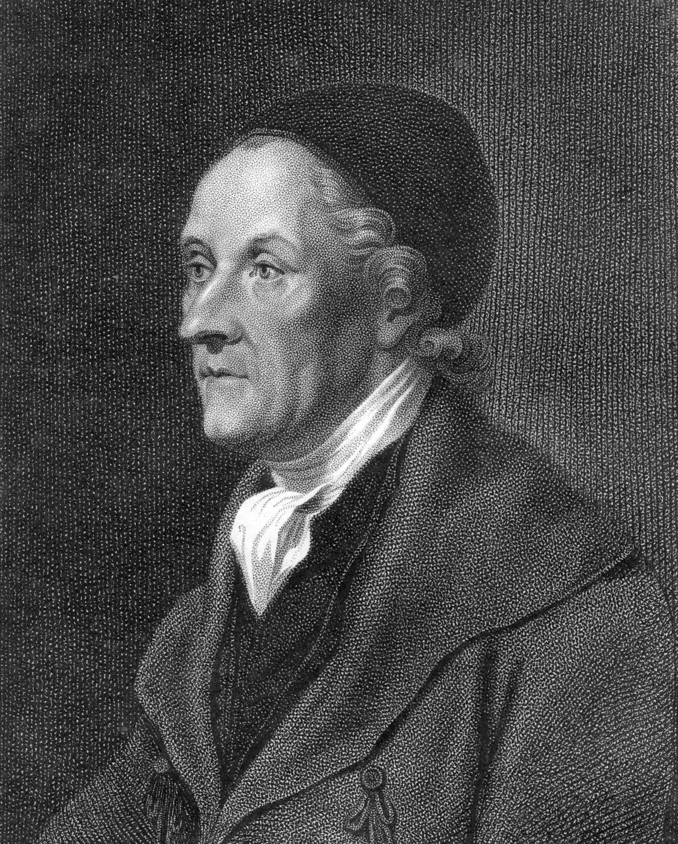
Physiognomy
Johann Caspar Lavater (1741-1801)
system of knowledge about human nature that claimed a direct link between the physical, outward appearance of a person and one's inward nature or character
explicate individual differences and help individuals understand their own nature and feelings, as well as those of others
It gave everyday people a psychological language and rubric with which to uderstand themselves and their neighbors: their feelings, their similarities, and their differences

Slide 19
Phrenology
the study of the conformation of the skull as indicative of mental faculties and traits of character, especially according to the hypotheses of Franz Joseph Gall (1758–1828), a German doctor, and such 19th-century adherents as Johann Kaspar Spurzheim (1776–1832) and George Combe (1788–1858)

Slide 20
04
Adam Smith
we act for our own interests, but in doing so we are mindful of the regard of others and that is what makes society possible

Slide 21
Adam Smith used the terms of INVISIBLE HAND and MORAL SENTIMENT to describe how all society benefits from personal development and self-control
INVISIBLE HAND → characterizes the mechanisms through which beneficial social and economic outcomes may arise from the accumulated self-interested actions of individuals, none of whom intends to bring about such outcomes
MORAL SENTIMENT→It shows that our moral ideas and actions are a product of our very nature as social creatures. It argues that this social psychology is a better guide to moral action than is reason. It identifies the basic rules of prudence and justice that are needed for society to survive, and explains the additional, beneficent, actions that enable it to flourish.

Slide 22
—Adam Smith
"No society can surely be flourishing and happy, of which the far greater part of the members are poor and miserable."

Slide 23
Thank you for the attention!

