Slide 1
SUBJECT MATTER, METHODS, AND THE MAKING OF A NEW SCIENCE
Lucija Vela
Department of Psychology

Slide 2

INTRODUCTION
two biggest chalenges in the proces of becoming an authoritative science in the late 19th century – to delineate and and to develop an appropriate method for the systematic study of this subject matter
natural science
question of the mind, soul, consciousness – if it could ever be conducted scientifically
Germany – the birthplace of a new science
scientists of the mind settled a method – EXPERIMENTAL INTROSPECTION – developed in Wilhelm Wundt´s psychology laboratory in Leipzig
subject of matter went went towards observable behaviour
this form of psychology was exemplified by functionalism

Slide 3
CAN PSYCHOLOGY BE A SCIENCE?
William James - psychology as a natural science, "requires a word of commentary"
RENE DESCARTES conceived of the mind as qualitatively distinct from the body, MIND –immaterial
Pineal gland is where the interaction occured
Interactive dualism
not completely materialistic model of the brain

Slide 4

KANT´S CHALLENGE
impediments to a natural science of the mind
2 separate domains of reality (one inside the human and one external)
NOUMENAL WORLD – when encountering the human mind it becomes transformed into the inner or phenomenal world
we never experience the pure reality, but a series of appearances

Slide 5
MIND is active rather than passive
it uses some rules, locates phenomena in time and space (intuitions)
mind has 12 categories – organizes phenomena according to them
mind could not be studied as other natural sciences, it is impossible to have any a priori knowledge of the human mind, one has to experience one´s own mind and use it as the basis of all knowledge, which is an empirical process
psychology can´t be rational nor empirical - mental phenomena have no psysical existence and are therefore not open to observation or experimental manipulation
observing the phenomena would change it
mental processes cannot be reduced to mathematics
psychology must always remain a historical, philosophical, and descriptive rather than scientific discipline

Slide 6
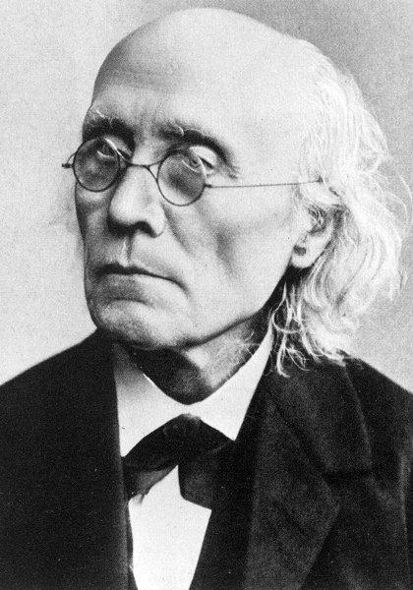
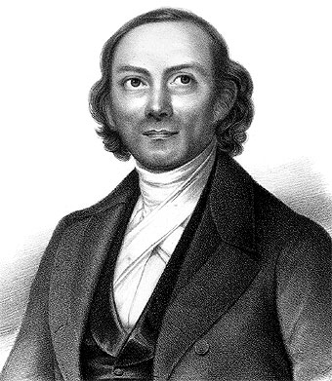
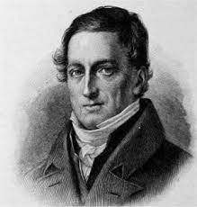
Kant´s heritage to psychology was a challenge
3 figures took up his challenge of making psychology mathematical:
Johann F. Herbart, Ernst H. Weber, Gustav T. Fechner – influential in creating psychophysics (studyinvolving the psychological phenomena)

Slide 7
PSYCHOPHYSICS AND THE POSSIBILITY OF A NEW SCIENCE
J. F. Herbart took as his task the extension of Kant´s system
Numbers could be assigned to psy. experiences of different intensities (presentations)
he had no way of relating them to an objective standard
stopped short of proclaiming that psychology could be experimental
automism – breaking down subject matter into its smallest elements for study

Slide 8
Ernst H. Weber – the role of mathematics in psychology, conducted experiments on his own senses
distinguishing weights between objects of similar appearance but different mass
established the " just – noticeable difference " for each sensory discrimination
Gustav Fechner – life after death and relationship of the physical world (the physic) with the psychological (the psyche) - psychophysics
all forms of life, from plants to humans, have some form of consciousness
Weber’s law - Fechner’s law
Elemente der Psychophysik (1860)

Slide 9

THE GERMAN INTELLECTUAL
TRADITION
professional faculties were law, theology, and medicine
the new system was modern, secular, and a clear break from the medieval university
the new universities emphasized the pursuit of higher learning rather than training for professional or civil service careers
Lehrfreiheit, the freedom to teach, and Lernfreiheit, the freedom to learn
intellectual freedom and independence of thought
Wissenschaft

Slide 10
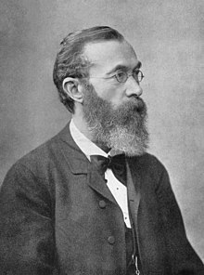
WILHELM WUNDT AND THE
NEW PSYCHOLOGY
Wundt built an apparatus he called the thought meter
principles of Physiological Psychology, published in 1874
experimental introspection
could provide automatic, repeated, and standardized presentations of stimuli
published a journal, Philosophische Studien, or Philosophical Studies
students in Wundt’s laboratory typically undertook investigations in one of three areas: psychophysics, studies of the time sense, and mental chronometry

Slide 11
PSYCHOLOGY IN BRITAIN AND FRANCE
France - Theodule Ribot - psychology could never be a positive science
associationism
England - Francis Galton - statistical research practices
THE NEW PSYCHOLOGY IN AMERICA
William James - The Principles of Psychology
mechanism, the position that all natural phenomena can be explained in terms of the causal interactions among material particles, without any reference to an external, supernatural force or agency
psychology as the ‘‘science of mental life’’
introspection - ‘‘the looking into our own minds and reporting what we there discover’’
functionalism
the point of a scientific psychology was to uncover the functions of the mind, not its contents or its structure

Slide 12
pragmatism, was the position that scientific ideas and knowledge can never be certain and therefore should be judged according to the work they do in the world, or according to their degree of practical effectiveness
a founder and active member of the American Society for Psychical Research
THE DEMISE OF INTROSPECTION IN AMERICAN PSYCHOLOGY
Titchener distorted Wundtian introspection and ignored the half of Wundt’s scientific psychology that belonged to Volkerpsychologie, often extending introspection to processes that Wundt felt were outside the realm of this kind of investigation
Thorndike, the Animal Mind, and Animal Behavior
the Expression of the Emotions in Man and Animals (Darwin)
Animal Intelligence (George Romanes) - anecdotal method
animals learn solely by trial and error and by reward and punishment

Slide 13
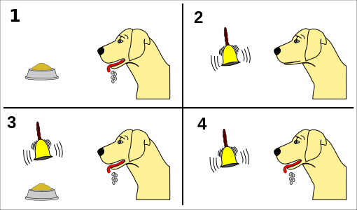
Pavlov, Animal Learning, and the Environment
through his work on the classical conditioning of reflexes in dogs, Pavlov demonstrated how the environment, or external stimuli, could come to control behavior, and he rejected ‘‘mind’’ as the cause of behavior
his view of thinking was atomistic and reflexive; that is, he believed that thinking consisted of elementary associations and the formation of chains of associations that could be traced to external conditions
Perry and Changing Beliefs About the Nature of Consciousness
Perry concluded that mentalistic psychology is misguided because consciousness is not private, known only to oneself, and shared only through introspection
consciousness is a collection of sensations derived from the external world or our own bodies

Slide 14
Watson and the Rise of Behaviorism
psychology ‘‘as the behaviorist views it’’ is a ‘‘purely objective experimental branch of natural science´´
Mary Whiton Calkins - opposed to the wholesale elimination of introspection as a psychological method and remained certain that some psychological processes could be studied only by introspection
BEHAVIORISM AND AMERICAN LIFE
the need for behaviorism in the face of the challenges of urban life
Watson and Rayner conducted their famous Little Albert experiment, in which they produced a fear of a white rat in a young infant by pairing the presentation of the rat (and other furry items) with a loud sound

Slide 15



THANK YOU FOR ATTENTION!

