Slide 1
The Century of the self-Part1
Happiness machines

Slide 2
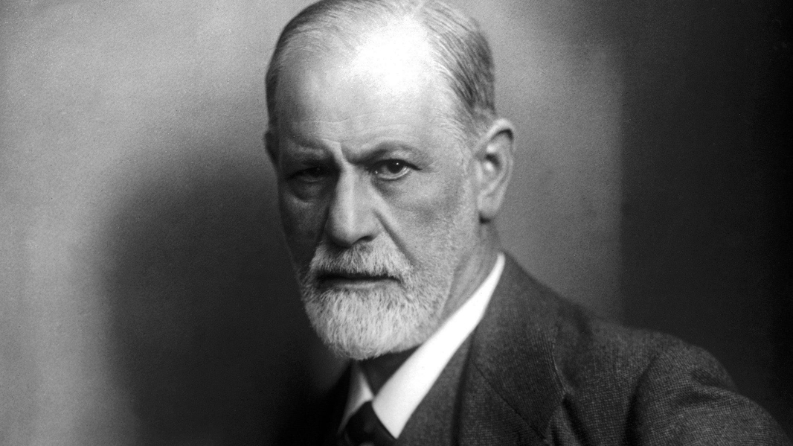
Sigmund Freud

Slide 3
Austrian neurologist
Founder of psychoanalysis
Theory of primitive, human ,subconscious drives ( such as libido)

Slide 4
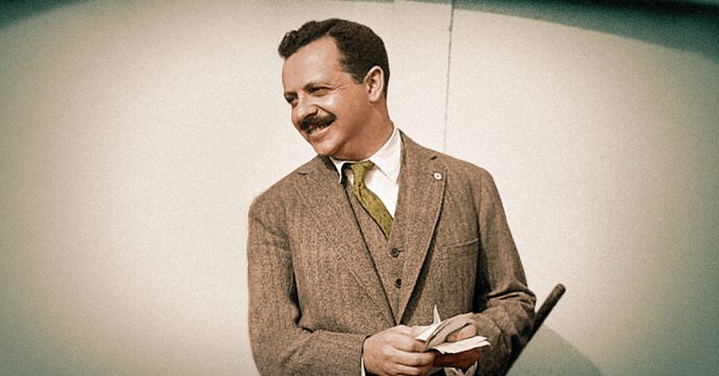
Edward Bernays

Slide 5
American pioneer in the field of public relations and propaganda
Nephew of Freud
Flourished the american consumerism using psychoanalytic theory (Freud s work)
Later promoted and introduced Freuds books to North America
Author of : Propaganda,Public Relations,Crystallizing Public Opinion,...
Used propaganda (public relations) to thigten relationship between products and consumers
Coined the term public relations

Slide 6
Cigarettes
Cigarettes were only allowed for men to smoke in public
Women were excluded from smoking
Psychoanalyst Abraham Brill said that cigarettes are a symbol of penis and male sexual power
Edward Bernays with the help of AA Brill s knowledge tried to sell cigarettes to women to have a wider marketing target for cigarette business
The plan was to connect the sales of cigarettes with challeging the male sexual power

Slide 7
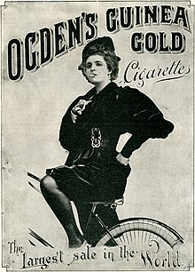
Torches of freedom

Slide 8
It happened on the day of Eastern Sunday Parade
Bernays reached out to rich debutantes and instructed them to hide the cigarettes under their clothes then they should join the parade and at the given signal from him they will light the cigarettes dramatically
Bernays informed the press that the group of suffragettes were prepearing a protest which they call the ”Torches of freedom ”
Symbol of challenging the male sexual power and liberty
Bernays plan worked

Slide 9
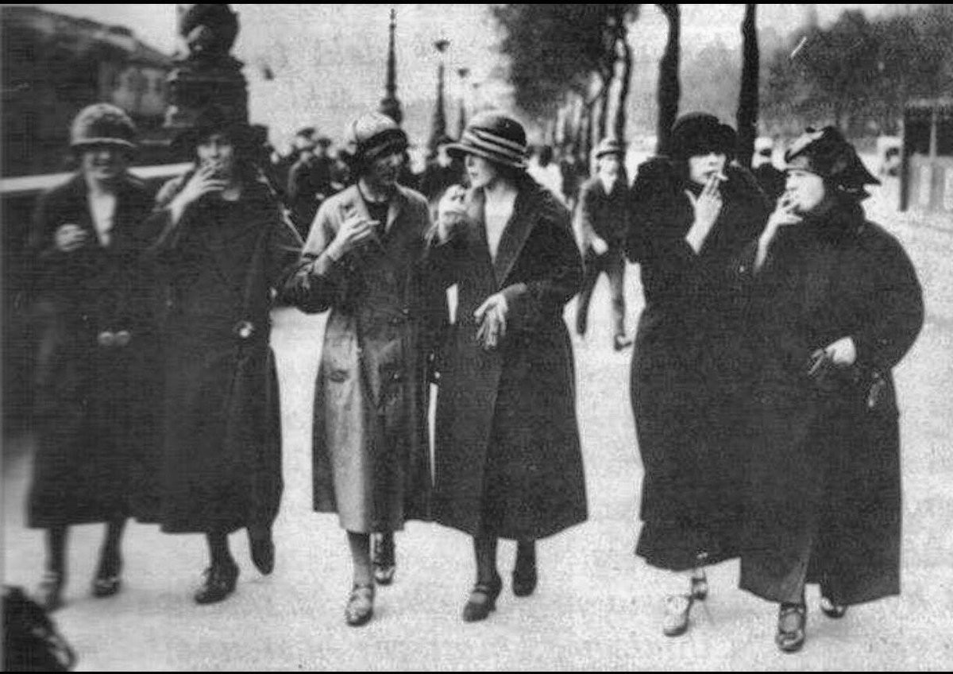
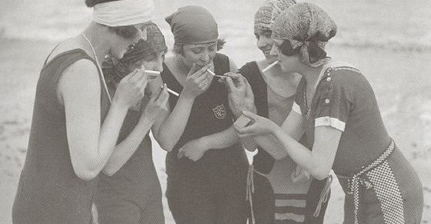

Slide 10
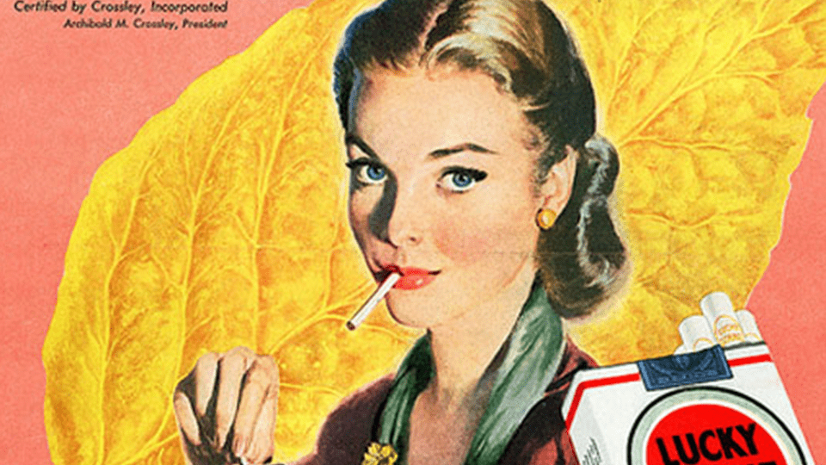

Slide 11
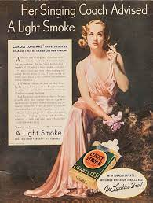
After the event sales of cigarrette rose
By staging the memorable and emotional event ,Bernays made smoking for women socially acceptable
Bernays created the idea if the woman smoked that made her independent and powerful, the idea still presist today
Afterwards Bernay had a revelation that people can behave irrationality if you linked the products with their emotional desires and feelings
The act that made women independent by smoking is irrational,but it made them feel independent

Slide 12
”Mans desires need to overshadow mans needs”
Products arent advertised for their functional or practical value but rather because of the feeling they envoke in people
Products potrayed by celebrities or actors
Products placement in movies
Cars-symbols of male sexualities
Bernays made psychologyst to issue the report that certain products are good for you and pretended that they were independent studies
Fashion shows ( clothing is an expression of character and personality)

Slide 13
Citizens became consumers
Bernay told that ordinary people should buy shares from the banks that he represented
Persuaded 34 famous film stars to visit the white house so for the first time politics became involved with the public relations

Slide 14
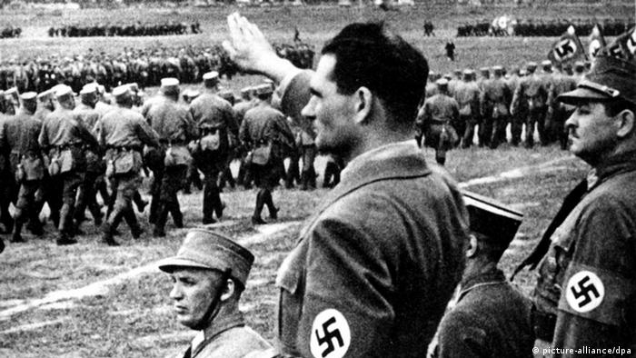
Collapsed market
29 of October 1929
Bernays and proffesion of public relations fell out of favor,
Rise of Nazism after the great depression
- banned the democracy and used Freuidian ideas
-lead people by allowing them to express dangerous but controlled primal urges

Slide 15
Bernay (public relations)
Rousevelt
Mechanism of the mind is irrational
Driven by the emotion and dark impulses
Unconscious
Democracy is strongly and only tied to capitalism
President Hoover -happiness machines- economic progress
People are not in charge but their desires are
Job of goverment is to regulate and control big buisnisses
People can give valuable opinions on politics and take part in running the country
People are rational –scientific polling-measuring and predicting behaviour of public by asking strictly factual questions and avoiding controlling peoples emotions

Slide 16
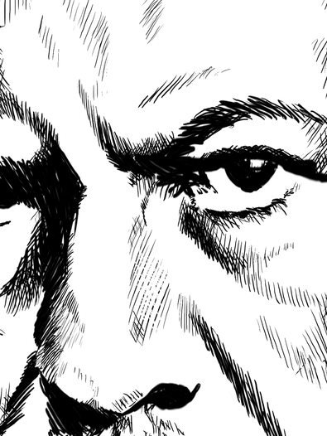
Pessimistic Freud
More pessimistic additude after publications of his work in america
Man is a member of bad species that can not be improved
Individual freedom is impossible because it is dangerous
Civilization is meant to keep people in check
Aggressive forces unleashed unto members outside of their group
Libidal forces projected unto a leader and are bounded by them

Slide 17

THANK YOU

