Slide 1
FROM PERIPHERY TO CENTER:
CREATING AN AMERICAN PSYCHOLOGY

Slide 2
Introduction
In American colleges, the dominant approach to explaining human thought and behavior was a mental and moral philosophy grounded in Scottish common sense realism
This movement involved religion, phrenology, mesmerism, and eventually, spiritualism and New Thought
Once introduced, this new Psychology underwent a remarkable naturalization or, more accurately, indigenization

Slide 3
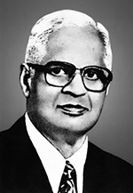
Early 19th century
Indigenization - process whereby a local culture or region develops its own form of psychology, either by developing it from within that culture or by importing aspects of psychologies developed elsewhere and combining them with local concepts
Durganand Sinha - endogenous and exogenous indigenization
Part of this indigenization process was the conflicted encounter between the proponents of the emergent everyday psychology—mind science, New Thought, spiritualism—and the new, graduate-trained psychologists who viewed themselves as scientists
Psychological sensibility > use of the new sciences of phrenology and mesmerism

Slide 4
Late 19 century
Spiritualism and New Thought built
New Psychology was rooted in the pragmatic approach - functionalism
Psychologists made the claim that their knowledge and methods led to more successful applications to problems of American society than either the earlier mental philosophy or the mind sciences of phrenology, mesmerism, New Thought, or spiritualism

Slide 5
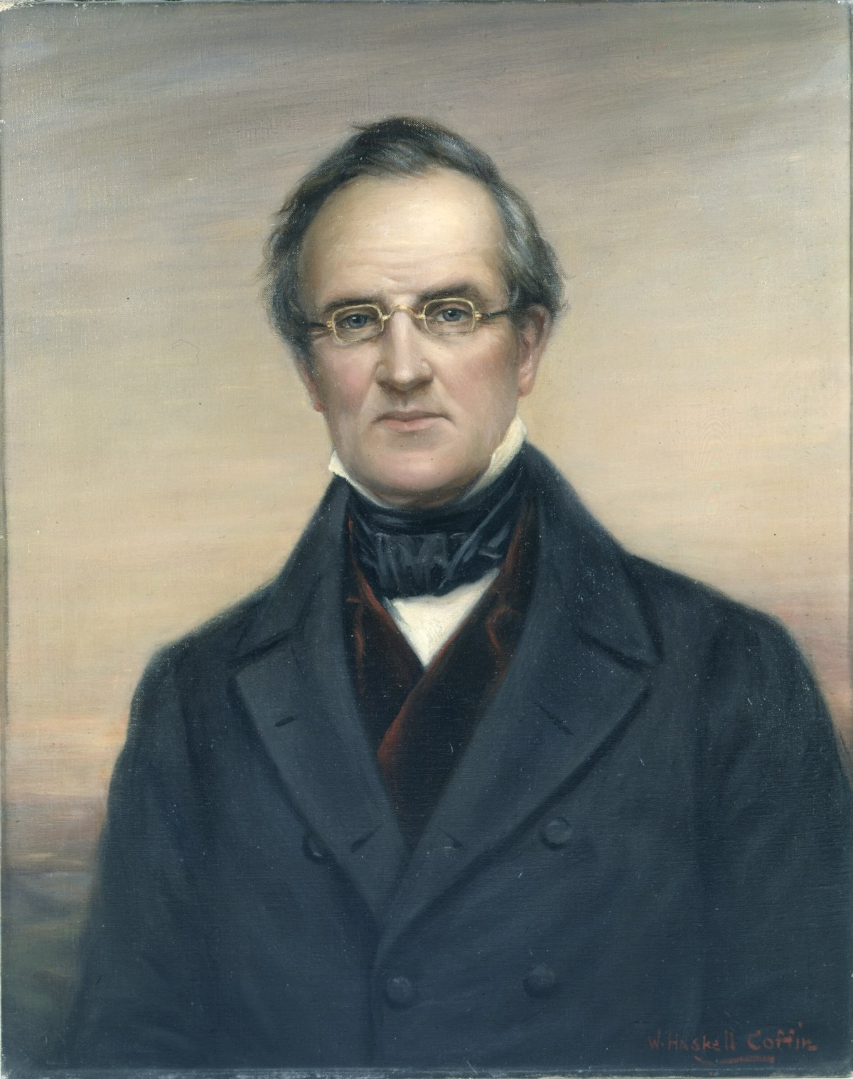
American mental and moral phylosophy
Deism - belief that although God designed the universe and set the clockwork in motion, He had no direct influence, and did not intervene, in the day-to-day affairs of humans
Witherspoon > change the course of American philosophy by providing not just intellectual guidance but moral guidance as well
Moral philosophy - branch of philosophy that dealt with ethics and conduct
Mental philosophy - dealt with the elements and processes of the mind and how they influenced action
Thomas Upham> „Elements of Intellectual Philosophy” (1827.)- emphasized the active processes of the mind
James McCosh >regarding evolution as an example of God’s handiwork
Psychological sensibility>exciting developments>religion

Slide 6
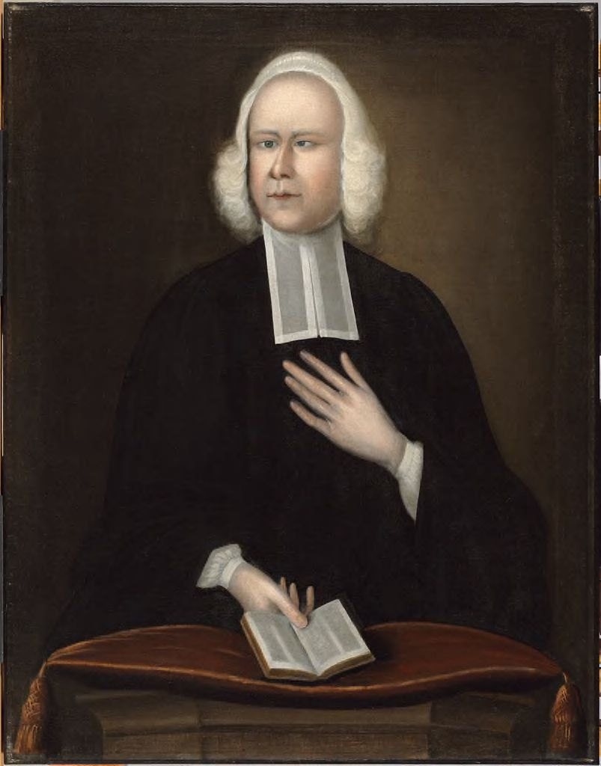
Religion and Revival
First Great Awakening- 1730s and 1740s> period marked by renewed religious fervor and conversion across New England
Jonathan Edwards > articulated a religious psychology that characterized the soul as an inseparable unity of understanding, will, and affections
George Whitefield and John Wesley > Methodist revivalism > openness to deep and profound religious experiences, (shouting, falling down, visions, and trance-like behaviors)
19th century- Methodism, Seventh-Day Adventism, and Mormonism
Shout tradition- demonstrations of conversion and personal transformation

Slide 7
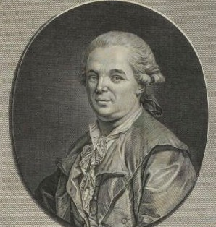
Mesmerism and Religion
Franz Anton Mesmer > Mesmerism
The mesmeric state - a deep connection between the mesmerist and the subject; the connection was one of sympathy between the two - later suggestibility
Once in this state, it was thought individuals could be directed to perform physical and intellectual tasks that were outside their capacity in the normal state
Marquis de Puysegur > expanded the psychological possibilities of mesmerism> magnetic somnabulism > hypnosis
Often combined with phrenology and was part of the armamentarium of itinerant healers and lecturers
David Schmit > Mesmerism as a way to understand the workings of the human mind normally hidden from view
La Roy Sunderland > sought to understand the religiously inspired phenomena in psychological terms > „The Magnet” > theorizing about the connections between the mesmeric state and the experiences of those caught up in religious ecstasies> atempted to merge mesmerism with phrenology
Placebo

Slide 8
Spiritualism
Spiritualism- a new religious movement based on the belief that the spirits of the dead exist and have both the ability and the inclination to communicate with the living
Link between spiritualism and mesmerim- mesmeric state was like a doorway into the spirit realm, providing empirical and verifiable proof of the existence of that realm- natural rather than supernatural
Immortality of souls and afterlife
American Civil War (1861–1865)
Late 19th century- spirtitualism was psychology

Slide 9
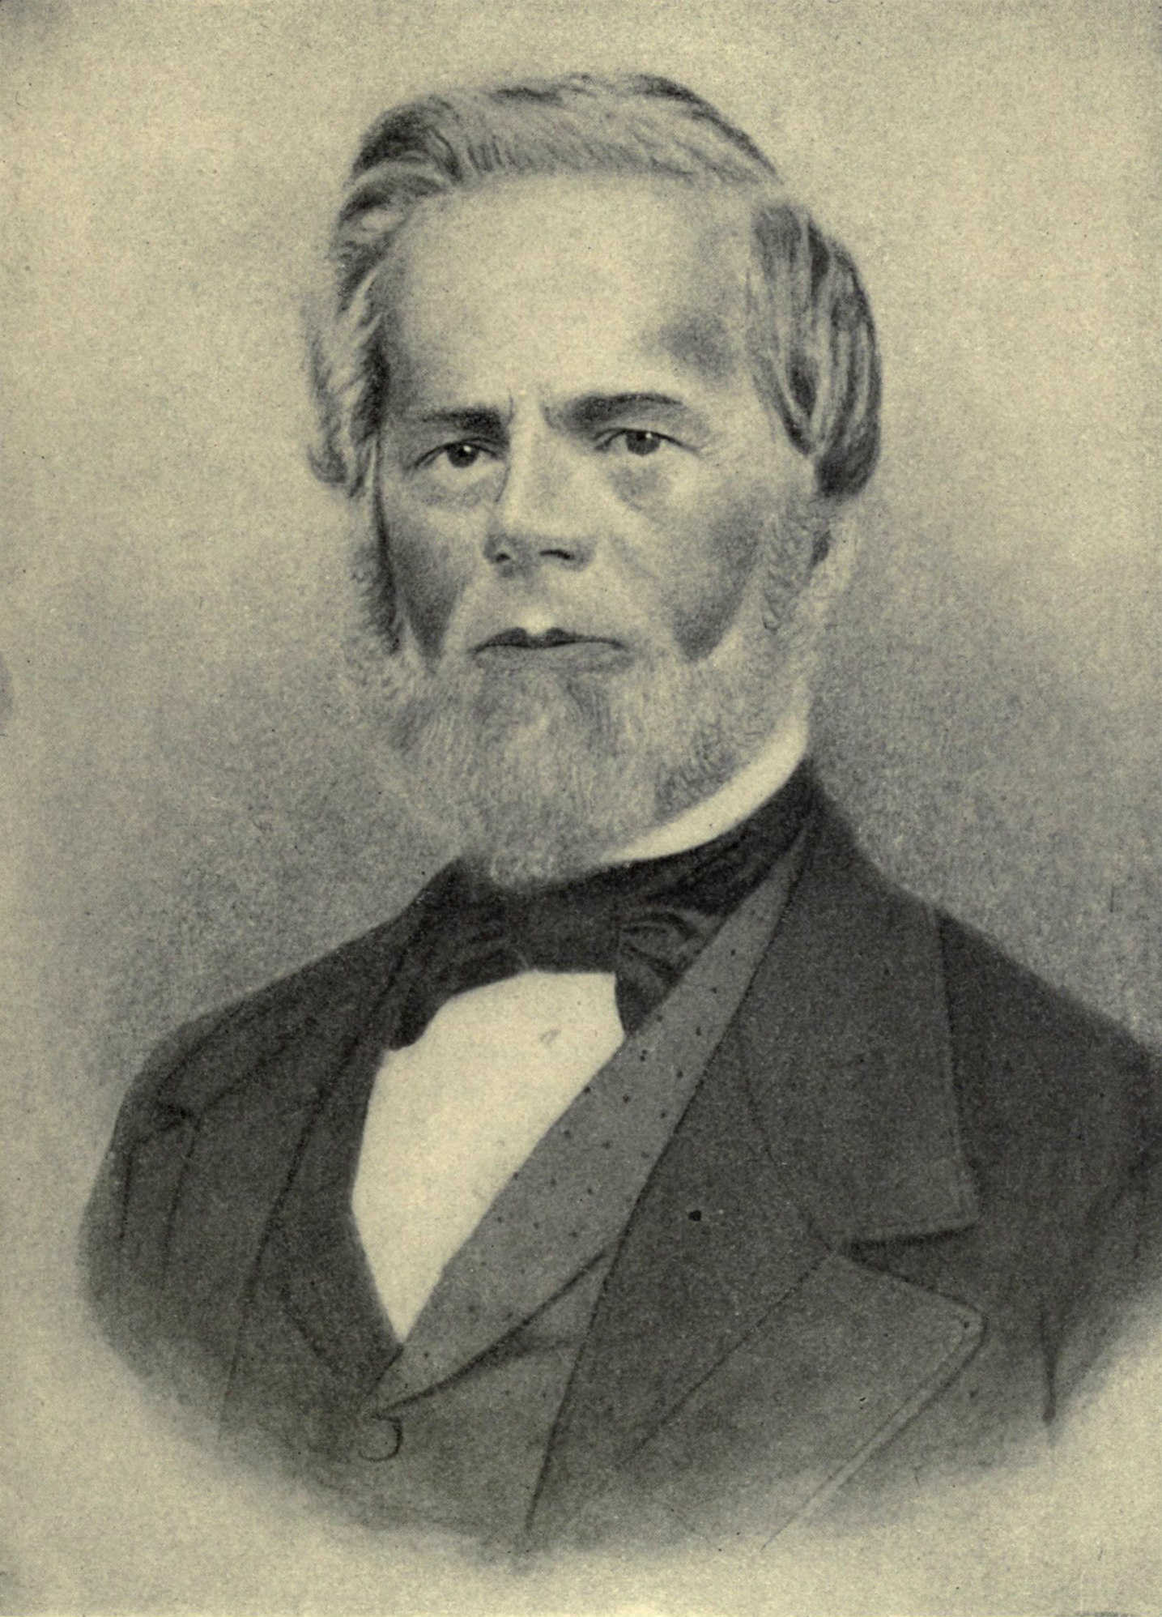
New Thought
Phineas P. Quimby > new metaphysical movements in the late 19th century > moved beyond mesmerism to a practice of psychological healing
Quimby’s work led to a mental science what became known as New Thought (1890s)
Mary Baker Eddy > Christian Science
His method was one of intense empathy with the other person so that, as he said, he could then see the false belief that was the true cause of the illness > correct the false belief and the person experienced healing
Those who embraced New Thought, mental science and healing were solidly grounded in an everyday psychology of human experience

Slide 10
Psychical Phenomena
The Society for Psychical Research (SPR) – England, 1882.
The American Society for Psychical Research (ASPR) – USA, 1885.
The purpose- scientifically investigate psychical phenomena
Mesmerists, spiritualists, clairvoyants, mind readers, and mediums, astrologers, palmists, phrenologists, and faith healers energy healers and phrenologists
The ASPR created committees to investigate > thought transference, hypnotism, telepathy, clairvoyance, and trance states
William James - If there was any validity to the phenomena, they would certainly lie within the province of psychological science
Sensibility

Slide 11
Boundary work and the new psychology: establishing the center and making the pheriphery
Psychology distinct from phylosophy >using the experimental methods > studying mental processes
Psychology laboratories , journals, textbooks and separate departments
Psychologists had to create institutional space and legitimacy for their new discipline and secure their status as psychological experts in the eyes of the public
Questions of the late 1800s > communication with the dead, whether mental telepathy was real, and whether psychics or seers could actually foretell the future
Psychologists felt their connection with spiritualism endangered their scientific credibility > one strategy was to denounce it altogether and distance themselves from these alternative psychologies

Slide 12
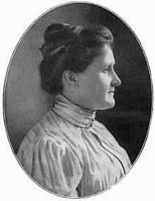
Maintaining scientific credibility and psychic phenomena
Terminological obfuscation > a way to conduct psychological research with funds designated for psychical research
Psychologists as the only experts qualified to evaluate spiritualism by using careful, systematic, scientific methods
G. Stanley Hall and Amy Tanner > the case of Leonora Piper
Harmony between religion and psychology- psychoanalysis

Slide 13
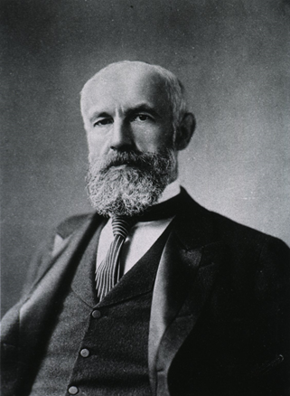
Organizing for Science
American Psychology Association (APA) > G. Stanley Hall - July 1892, 31 individuals
Hall was the first president
The first meeting of APA was held in December 1892 at the University of Pennsylvania
APA played a critical role in making psychology a recognized science in this era
American Journal of Psychology > America’s first scientific journal devoted to psychology

Slide 14
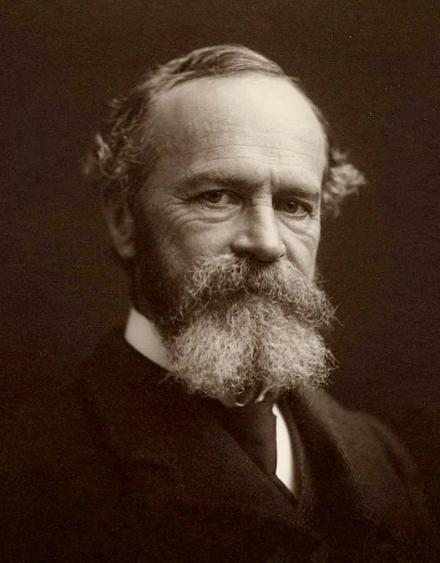
Making Psychology Useful
William James:
Functionalism- the goal of psychology was to understand how the mind and its contents had evolved by looking at the functions of different thoughts and beliefs, functions that were objectively observable in terms of actions
The implications of functionalist psychology were that it held promise of usefulness

Slide 15
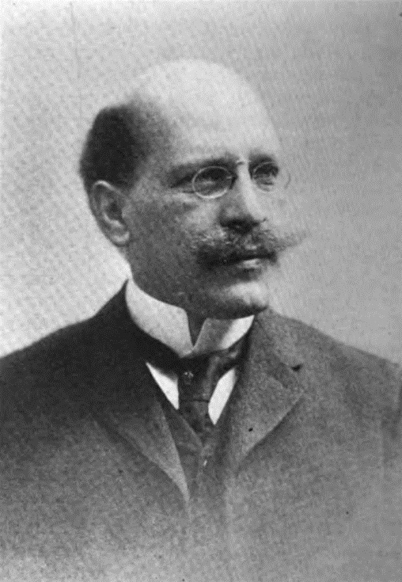
Engaging the Public
1890-1920- Psychologists such as Hall wrote about religion and psychology and others wrote about psychology and education
Education, industry, advertising, and personnel selection > psychologists promised the public that their science was up to the task of improving performance through understanding the psychology of the people involved
Munsterberg:
Use of psychology in the court system- usefulness of psychology in eyewitness testimony
One of the first American books on psychotherapy, in 1908.
Human relations and efficiency in the workplace

Slide 16
Education: The Pay Vein That Supports the Mine
G. Stanley Hall > making education the first real application of psychology- the child study movement.- 1870s
The professional school administrator > educational psychologists > quantitative studies indicating the best ways to measure educational outcomes
Educational psychology > how to place children and how to manage the institutions
1910.- psychologists began to develop expertise with school-related problems and helping schoolchildren
Henry H. Goddard> brought the first test used to measure intelligence to the United States from France
Lewis Terman > Stanford-Binet Tests of Intelligence
Lightner Witmer > clinical psychology

Slide 17
Psychologists in Industry
Psychologists and advertising and psychologists and industrial efficiency- social management
Frederick Winslow Taylor >„Principles of Scientific Management” (1911.),- business and industry could be studied scientifically and placed on a rational and orderly basis
Hugo Munsterberg:
laboratory, first-rank site for experimental work
one of foremost advocates and popularizers of applied psychology.
1908. - ‘‘trial of the century’’- „On the Witness Stand”- first example of forensic psychology
„Psychology and Industrial Efficiency”
Lillian Moller Gilbreth > improvement in working conditions of workers
Walter Dill Scott > business psychology- „Theory of Advertising” (1903.), „Psychology of Advertising” (1908.), „Increasing Human Efficiency in Business” (1910.)
Walter Van Dyke Bingham > experimental psychologist- created a division of applied psychology

Slide 18
Thank you!
History of psychology
Nika Vuco
Psychology – Faculty of humanities and social sciences Split

